Slide 1

Developer Technology Trends: Stack Overflow Survey Analysis
Data Analyst Capstone Project
Oluwakanyinsola Ifeoluwa Adebanjo
October 8, 2026

Slide 2



OUTLINE
Executive Summary
Introduction
Methodology
Results
  Job Postings | Popular Languages
  Programming Language Trends + Findings & Implications
  Database Trends + Findings & Implications
Dashboard
  Tab 1: Current Technology Usage
  Tab 2: Future Technology Trends
  Tab 3: Demographics
Discussion
Overall Findings & Implications
Conclusion
Appendix: Cloud Platforms, Web Frameworks, IDEs

Slide 3

EXECUTIVE SUMMARY
Stack Overflow Developer Survey: 18,845 professional developers analysed
Languages: JavaScript (79%), SQL (67%) and HTML/CSS (66%) lead today; they stay on top next year
Rising languages: Rust and Go are the fastest-growing choices (wanted by 2.5x and 1.7x more developers than use them)
Databases: PostgreSQL dominates now (61%) and next year (65%); Redis climbs to #2
Cloud: AWS leads platforms (58%), ahead of Azure (36%) and Google Cloud (29%)
Tools: Visual Studio Code is the most popular IDE (80%), followed by Visual Studio and IntelliJ IDEA
Who responded: 69% are aged 25 to 44; 46% hold a bachelor's degree; the USA, Germany and India lead
Jobs and pay: Swift, Python and C++ pay the highest average salaries (US$114K to US$131K)

Slide 4

INTRODUCTION
Purpose, target audience and value of the analysis
Purpose: help our IT and business consulting firm stay competitive by identifying in-demand and emerging technology skills
Target audience: firm leadership, consultants, hiring managers and training teams
Value: evidence-based guidance on which skills are in demand now and which are gaining momentum
Questions answered:
  Which technologies are rising or declining for next year?
  Who are the respondents (age, country, education)?
  Which programming languages, databases and IDEs are most in demand?

Slide 5

METHODOLOGY
Data Sources
  Stack Overflow Developer Survey subset (survey_data_updated.csv: 18,845 responses, 114 columns)
  Jobs API (jobs.json: 27,005 job postings)
  Programming-language salary web page (Programming_Languages.html)
Data Collection Methods
  Downloaded the survey CSV and loaded it with pandas; queried it with SQL in SQLite
  Called the Jobs REST API with Python requests and saved results to job-postings.xlsx
  Web-scraped salaries with BeautifulSoup and saved them to popular-languages.csv
Data Wrangling Steps
  Found and removed duplicate rows; confirmed ResponseId is unique
  Imputed missing values (most frequent value for categories, median for compensation)
  Normalised compensation (min-max, z-score, log) and removed outliers with the IQR method
  Split multi-select answers (e.g. "Python;SQL") into one row per technology
Analysis: pandas, matplotlib and seaborn for EDA; IBM Cognos Analytics for the dashboard

Slide 6

Results
The following slides present job postings, language salaries, and programming language and database trends.

Slide 7
JOB POSTINGS
Key observations
Washington DC has the most job postings (5,316)
Detroit, Seattle and New York each have more than 3,000
Los Angeles, San Francisco and Austin have far fewer (under 700 each)
Source: job-postings.xlsx (Jobs API lab, 27,005 job records)

Slide 8
POPULAR LANGUAGES
Key observations
Swift pays the most at $130,801 a year
Python ($114,383) and C++ ($113,865) follow closely
SQL and PHP are the lowest paid (about $85K) even though they are widely used
Source: popular-languages.csv (web scraping lab)

Slide 9
PROGRAMMING LANGUAGE TRENDS
JavaScript, SQL, HTML/CSS, TypeScript and Python lead both years. Go and Rust join the top 10 next year, replacing PHP and PowerShell.
Current Year
Next Year

Slide 10
PROGRAMMING LANGUAGE TRENDS - FINDINGS & IMPLICATIONS
Findings
JavaScript is the most used language (79% of respondents) and stays #1 next year (61%)
SQL, HTML/CSS, TypeScript and Python make up the rest of the top 5 in both years
Go and Rust enter next year's top 10; Rust is wanted by 2.5x more developers than currently use it
PHP and PowerShell drop out of next year's top 10, and Java falls from #8 to #10
Implications
JavaScript/TypeScript and SQL remain must-have skills for consultants and job seekers
Steady demand for Python supports growing data, AI and automation work
The firm should start training staff in Go and Rust to meet rising client demand
Teams relying on PHP or legacy scripting face a shrinking talent pool and should plan modernisation

Slide 11
DATABASE TRENDS
PostgreSQL leads both years by a wide margin. Redis rises from #6 to #2, while MySQL and Microsoft SQL Server lose ground.
Current Year
Next Year

Slide 12
DATABASE TRENDS - FINDINGS & IMPLICATIONS
Findings
PostgreSQL is #1 in both years: 61% use it now and 65% want to use it next year
Redis rises from #6 to #2 next year, and Supabase enters the top 10
MySQL drops from #2 to #4, and Microsoft SQL Server from #5 to #6
Oracle drops out of next year's top 10
Implications
PostgreSQL is the most valuable database skill to build or hire for
In-memory caching (Redis) is becoming standard in modern application stacks
Interest is shifting from proprietary databases (SQL Server, Oracle) to open-source options, lowering licence costs
The firm can offer PostgreSQL migration and cloud database services to clients

Slide 13

DASHBOARD
IBM Cognos Analytics dashboard: three tabs, 12 visualisations
Current Technology Usage: web stacks (HTML/CSS, JavaScript, TypeScript), PostgreSQL and AWS dominate
Future Technology Trend: the same leaders stay on top; interest grows in PostgreSQL, FastAPI and Phoenix
Demographics: most respondents are 25 to 44, hold a bachelor's degree and live in the USA, Germany or India

Slide 14
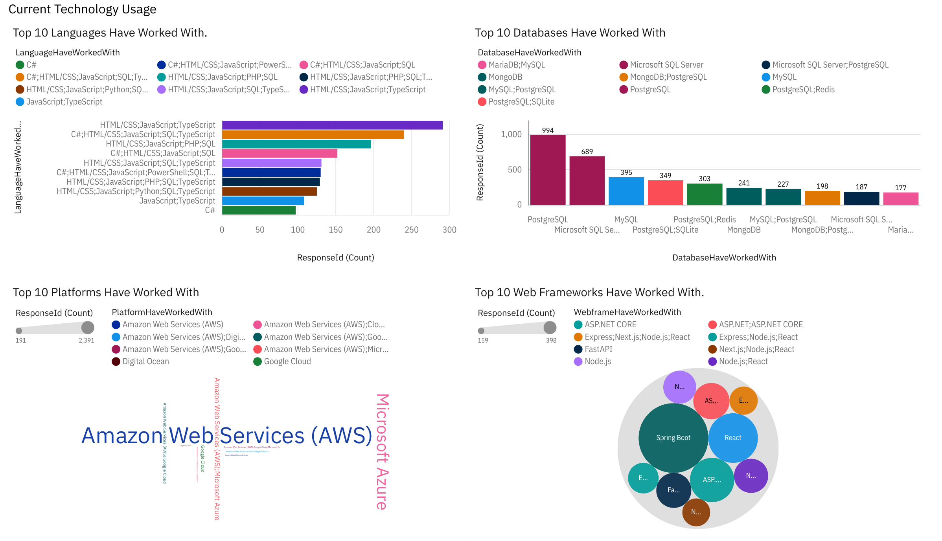
DASHBOARD TAB 1: Current Technology Usage
Dashboard insight
Front-end web stacks dominate: the top language combination is HTML/CSS + JavaScript + TypeScript
PostgreSQL is the most used single database (994 respondents use only PostgreSQL)
AWS is the leading cloud platform, followed by Microsoft Azure
Spring Boot, React and ASP.NET Core are the most common web framework answers

Slide 15
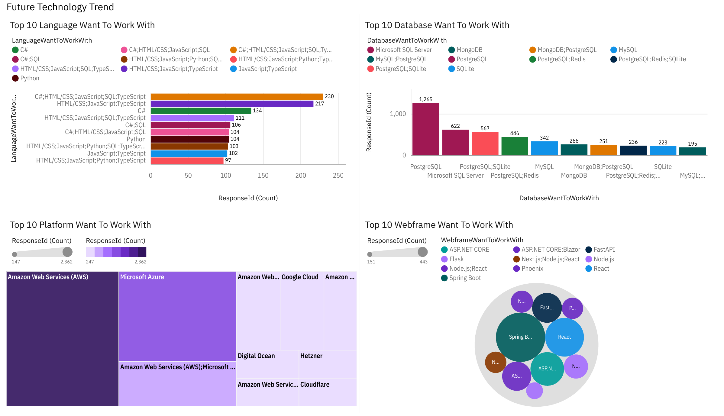
DASHBOARD TAB 2: Future Technology Trends
Dashboard insight
C#, HTML/CSS, JavaScript, SQL and TypeScript together is the most wanted language set
PostgreSQL interest grows: 1,265 respondents want only PostgreSQL next year
AWS and Azure remain the most wanted platforms
Spring Boot, React and ASP.NET Core stay top; FastAPI and Phoenix gain interest

Slide 16
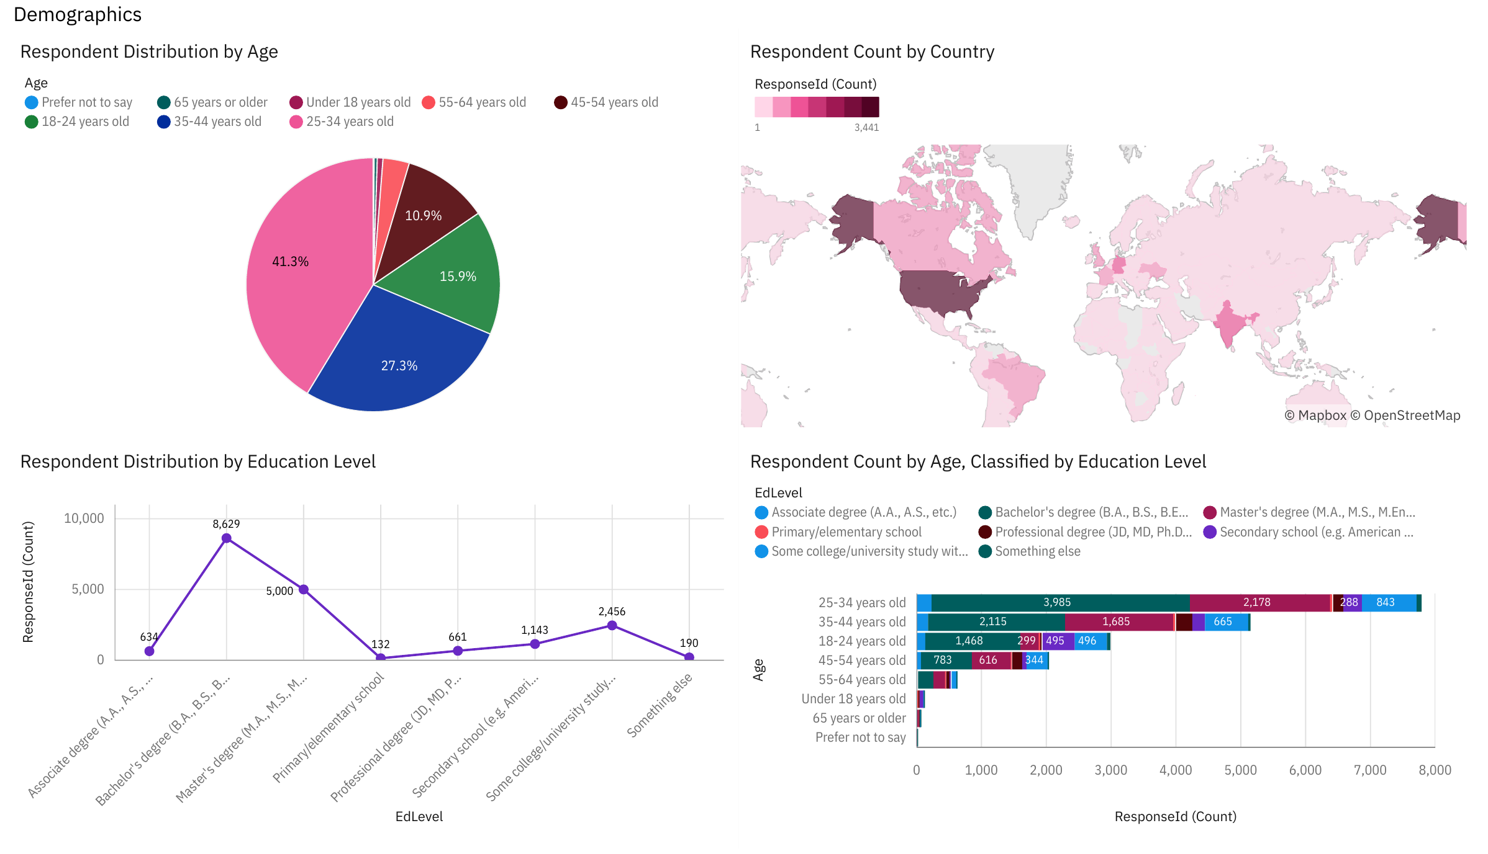
DASHBOARD TAB 3: Demographics
Dashboard insight
Ages 25 to 34 make up 41% of respondents; 35 to 44 add another 27%
The USA (3,441), Germany (1,339) and India (1,316) have the most respondents
A bachelor's degree is the most common education (8,629), then a master's (5,000)
Bachelor's holders are the largest group in every main age band

Slide 17
DISCUSSION
Overall insights from the dashboard
The developer community is young and highly educated: most are 25 to 44 with a degree
Today's stack centres on JavaScript, SQL, PostgreSQL and AWS, and the same tools lead next year
Interest is shifting toward newer, performance-focused tools such as Rust, Go, FastAPI and Redis
Many developers combine several technologies, so multi-skill profiles are the norm
Limitation: the data is a subset of the full survey, so results may not fully reflect the global developer community

Slide 18
OVERALL FINDINGS & IMPLICATIONS
Findings
JavaScript, SQL and PostgreSQL are the core skills both now and next year
Rust, Go, Redis and Supabase show the strongest growth in interest
AWS leads cloud adoption; most respondents are aged 25 to 44 with a degree
Implications
Industry: open-source tools (PostgreSQL, Redis) and cloud platforms (AWS) are becoming the default enterprise stack
Hiring: demand for Rust and Go may outpace supply, raising competition and pay for these skills
Training: universities, bootcamps and employers should update curricula toward cloud, PostgreSQL and modern languages

Slide 19

CONCLUSION
Web and data skills (JavaScript, TypeScript, SQL, Python) are the foundation of today's developer job market
PostgreSQL and AWS are the leading database and cloud platform, now and next year
Rust, Go and Redis are the technologies to watch, with interest growing faster than current use
An interactive Cognos dashboard lets stakeholders explore technology usage, trends and demographics

Slide 20

APPENDIX: CLOUD PLATFORMS
Notes
AWS leads both years (58% used, 56% wanted)
Cloudflare and Hetzner gain interest; Heroku drops out of the next-year top 10
0% = outside that year's top 10

Slide 21
APPENDIX: WEB FRAMEWORKS
Notes
Node.js and React lead both years (about 43 to 49%)
Next.js and Vue.js gain interest; jQuery and Express decline
FastAPI enters the next-year top 10
0% = outside that year's top 10

Slide 22
APPENDIX: MOST POPULAR IDEs
Notes
Visual Studio Code dominates: 80% use it and 72% want to keep using it
IntelliJ IDEA overtakes Visual Studio for next year
Neovim gains interest; WebStorm enters the next-year top 10
0% = outside that year's top 10

